Slide 1
input →
→ output

Slide 2
algorithms

Slide 3
1024
512
256
128
64
32
16
8
4
2
1

Slide 4
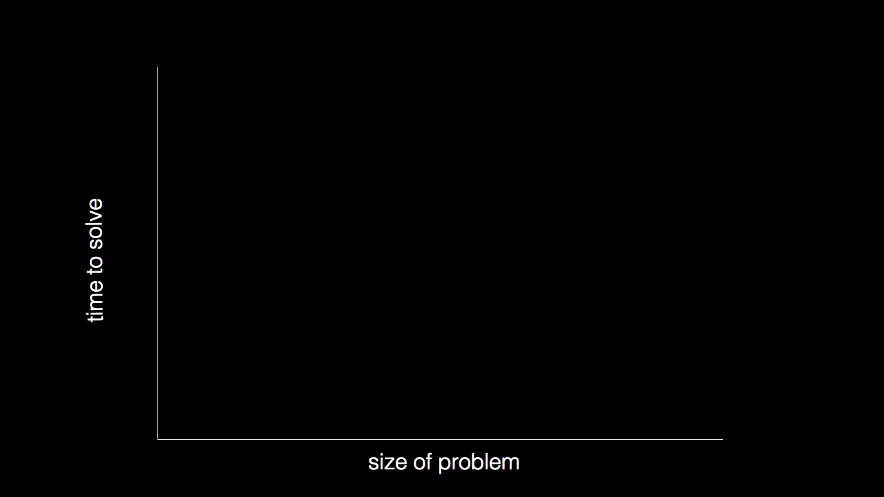

Slide 5
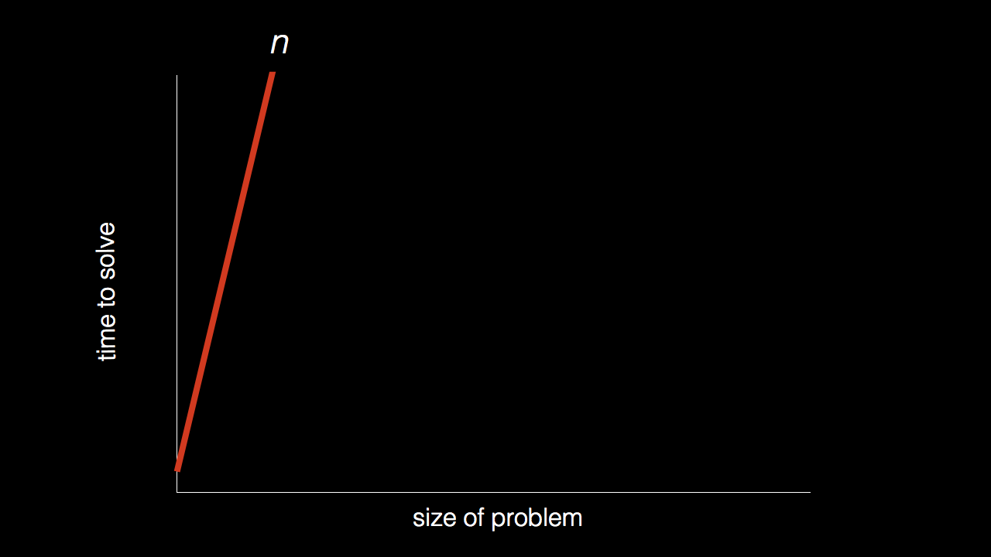

Slide 6
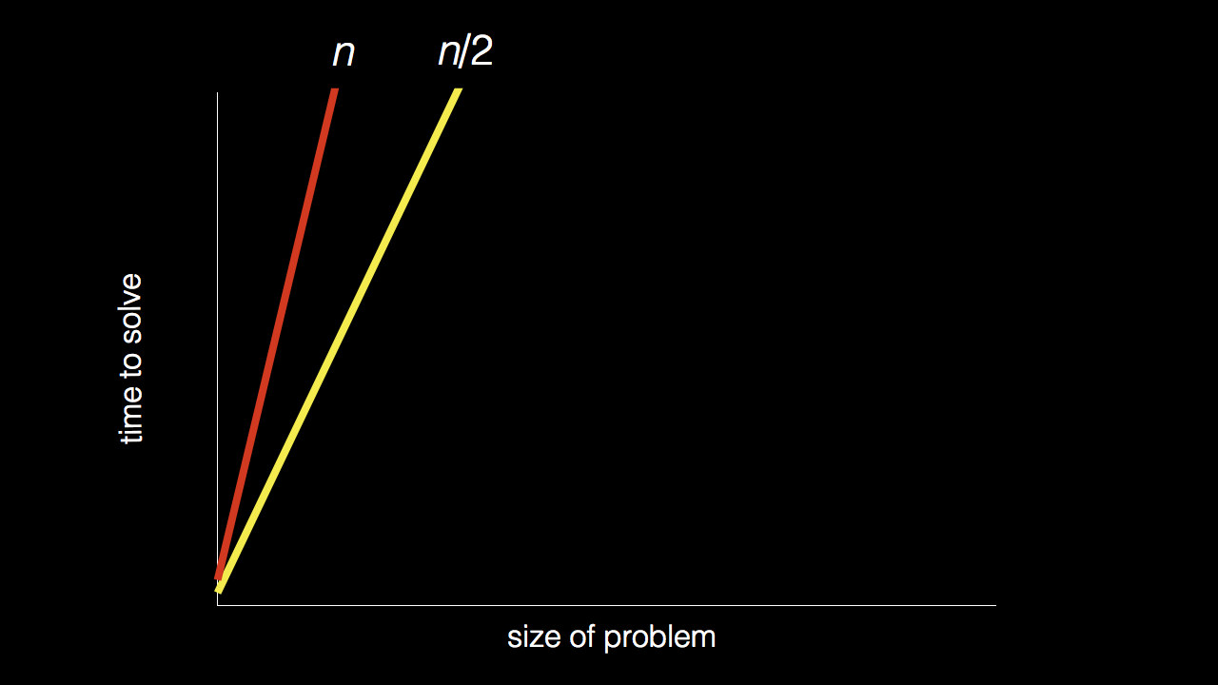

Slide 11
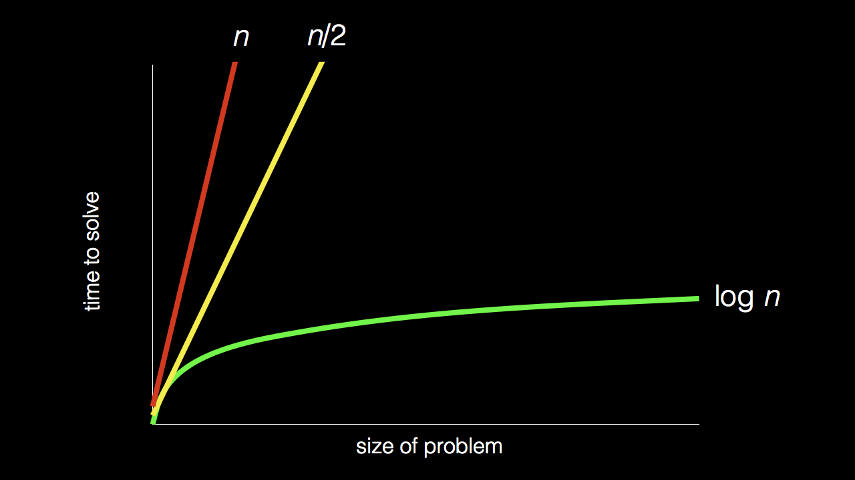

Slide 12
pseudocode

Slide 13
1 Pick up phone book
2 Open to middle of phone book
3 Look at page
4 If Smith is on page
5 Call Mike
6 Else if Smith is earlier in book
7 Open to middle of left half of book
8 Go back to line 3
9 Else if Smith is later in book
10 Open to middle of right half of book
11 Go back to line 3
12 Else
13 Quit

Slide 14
1 Pick up phone book
2 Open to middle of phone book
3 Look at page
4 If Smith is on page
5 Call Mike
6 Else if Smith is earlier in book
7 Open to middle of left half of book
8 Go back to line 3
9 Else if Smith is later in book
10 Open to middle of right half of book
11 Go back to line 3
12 Else
13 Quit

Slide 15
1 Pick up phone book
2 Open to middle of phone book
3 Look at page
4 If Smith is on page
5 Call Mike
6 Else if Smith is earlier in book
7 Open to middle of left half of book
8 Go back to line 3
9 Else if Smith is later in book
10 Open to middle of right half of book
11 Go back to line 3
12 Else
13 Quit

Slide 16
1 Pick up phone book
2 Open to middle of phone book
3 Look at page
4 If Smith is on page
5 Call Mike
6 Else if Smith is earlier in book
7 Open to middle of left half of book
8 Go back to line 3
9 Else if Smith is later in book
10 Open to middle of right half of book
11 Go back to line 3
12 Else
13 Quit

Slide 17
1 Pick up phone book
2 Open to middle of phone book
3 Look at page
4 If Smith is on page
5 Call Mike
6 Else if Smith is earlier in book
7 Open to middle of left half of book
8 Go back to line 3
9 Else if Smith is later in book
10 Open to middle of right half of book
11 Go back to line 3
12 Else
13 Quit

Slide 18
algorithms
input →
→ output

